Slide 1
Chapter 13 Web Security
Web services security standards: SAML, XACML. REST security.
Web attacks: XSS, CSRF

Slide 2
Web Services
A Web Service (XML web service) is a type of component that is available on the web and can be incorporated in applications or used as a standalone service
Requires a standards-based supporting framework
The web was intended to become a marketplace of web services (did not quite happen)

Slide 3
Use of web services

Slide 4
SOAP
Originally defined as Simple Object Access Protocol, is a protocol specification for exchanging structured information in the implementation of web services.
It uses XML for its message format, and usually relies on other Application Layer protocols, most notably Remote Procedure Call (RPC) and Hypertext Transfer Protocol (HTTP), for message negotiation and transmission
SOAP can form the foundation layer of a web services protocol stack, providing a basic messaging framework upon which web services can be built.
This protocol consists of three parts: an envelope, which defines what is in the message and how to process it, a set of encoding rules for expressing instances of application-defined data types, and a convention for representing procedure calls and responses.

Slide 5
Simple Object Access Protocol
<SOAP-ENV: Envelope
xlmns:SOAP-ENV=” http://schemas.xmlsoap.org/soap/envelope/”
….
<SOAP-ENV: encoding style= “…” >
<SOAP-ENV:Header>
</SOAP-ENV:Header>
<SOAP-ENV:Body>
….
</SOAP-ENV: Body>
</SOAP-ENV:Envelope>

Slide 6
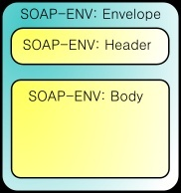
SOAP

Slide 7
Representational State Transfer (REST)
REST is a style of architecture for distributed hypermedia systems such as the WWW
REST exemplifies how the Web's architecture emerged by characterizing and constraining the macro-interactions of the four components of the Web, namely origin servers, gateways, proxies and clients, without imposing limitations on the individual participants.
REST-style architectures consist of clients and servers.
Clients initiate requests to servers; servers process requests and return appropriate responses. Requests and responses are built around the transfer of representations of resources.
A resource can be any coherent and meaningful concept that may be addressed. A representation of a resource is typically a document that captures the current or intended state of a resource.

Slide 8
RESTful web services
A RESTful web service (also called a RESTful web API) is a simple
web service implemented using HTTP and the principles of REST. It is
a collection of resources, with three defined aspects:
the base URI for the web service, such as http://example.com/resources/
the Internet media type of the data supported by the web service. This is often JSON, XML or YAML but can be any other valid Internet media type.
the set of operations supported by the web service using HTTP operations (e.g., POST, GET, PUT or DELETE).

Slide 9
REST and web services
A RESTful web service (also called a RESTful web API) is a simple web service implemented using HTTP and the principles of REST. It is a collection of resources, with three defined aspects:
the base URI for the web service, such as http://example.com/resources/
the media type of the data supported by the web service. This is often JSON, XML, or YAML but can be any other valid Internet media type.
the set of operations supported by the web service using HTTP methods (e.g., POST, GET, PUT or DELETE).
A good overview:
A. Rodriguez, “RESTful web services: the basics”
http://www.ibm.com/developerworks/webservices/library/ws-restful/

Slide 10
REST or SOAP?
Most of the web functionality on the Internet now uses REST: Twitter, Yahoo’s web services use REST, others include Flickr, del.icio.us, pubsub, bloglines, technorati, and several others. Both eBay and Amazon have web services for both REST and SOAP.
SOAP is mostly used for Enterprise applications to integrate wide types and large number of applications and another trend is to integrate with legacy systems, etc. Google is consistent in implementing their web services using SOAP, with the exception of Blogger, which uses XML-RPC.
REST is a low-level protocol and cannot enforce precise security

Slide 11
Web security
Web services security standards
XACML
XML Encryption (already seen)
SAML
REST threats
Web threats: XSS, CSRF
Security Products: XML Firewall

Slide 12
Web services standards
We need many standards such that the services are self-descriptive and can interoperate with any platform (hardware, OS, language).
For security we need to specify all the ways for web services to interact in a secure way
Standards form a hierarchy where basic standards are used as building blocks by more complex standards

Slide 13
WS standards
Security Standards
WS- SecureConversation
WS-Federation
WS-Authorization
WS-Policy
WS-Trust
WS-Privacy
WS-Security
XKMS
SAML
XACML
SPML
SOAP Foundation
XML Encryption
XML Digital Signature

Slide 14
Standards for web services security

Slide 15
Patterns for web services security

Slide 16
WS-Security
Standard from IBM, Microsoft, and Verisign
Defines security tokens to be attached to SOAP messages
Tokens may include username tokens, SAML assertions, X. 509 certificates, LTPA Binary Tokens, and Kerberos tickets
Tokens can be used for claims of authentication or rights

Slide 17
Advantages of WS-Security
Different parts of a message can be secured in a variety of ways. For example, you can use integrity on the security token (user ID and password) and confidentiality on the SOAP message body.
Intermediaries can be used and end-to-end message-level security can be provided through any number of intermediaries.
WS-Security works across multiple transports and is independent of the underlying transport protocol.
Authentication of both individual users and multiple party identities is possible.

Slide 18
XACML [Fer13]
Special technical committee of OASIS
Specification of policies for information access over the Internet and their enforcement
Combines work of IBM Tokyo and University of Milano, Italy.
Implemented by Sun in early 2003
Defines access matrix authorization rules to control access to documents or portions of a document
Rule has subject, right, object, and condition
Separate rule definition from enforcement

Slide 19
Enforcement: Reference Monitor

Slide 20
Components of Access control
Policy Enforcement Point defines application of enforcement (Reference Monitor and Reified Reference Monitor)
Policy Authorization Point (Policy Definition Point) includes information needed for authentication and authorization
Policy Information Point adds context information to make acess decisions
ContentInspector checks for harmful data (wrong parameter lengths and types), conformance with predefined schema, can do encryption and decryption of documents, and verify signatures

Slide 21
Reference monitor pattern [Fer13]

Slide 22
Reified Reference Monitor

Slide 23
RRM
In the RRM the decision, instead of being ‘yes’ or ‘no’, is a class to which we can apply operations (reification)
There is zero or one decision per request
Information about the context or any other information can be used to produce the decision

Slide 24
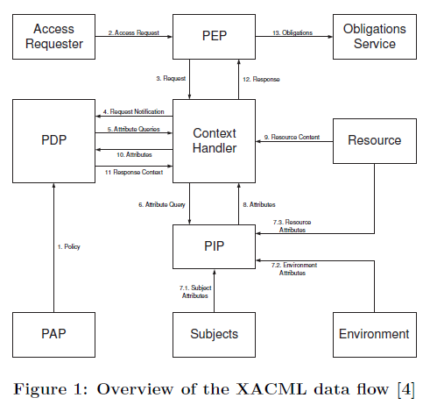

Slide 26
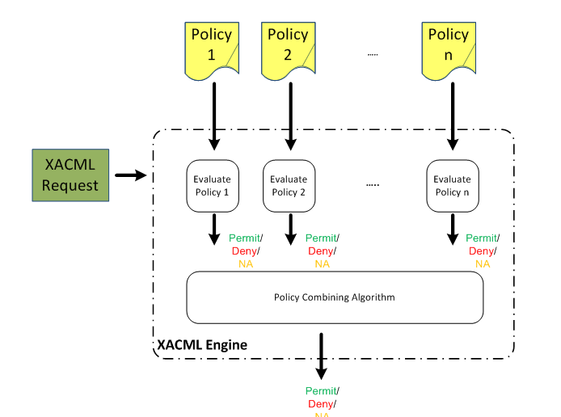

Slide 28
Abstraction in the use of patterns
We can see the Composite and Authorization patterns in XACML Authorization
We can see the Reference Monitor in XACML Evaluation
Abstraction helps model understanding

Slide 29
Security Assertion Markup Language (SAML)
Part of XML-based Security Services
XML framework for exchanging authentication and authorization information
SAML information can be added to XML messages
11/26/2018
29

Slide 30
Three types of assertions
Authentication
Authorization
Attributes (groups, roles,…)

Slide 34
SAML Assertion model [Fer13]

Slide 35
WSDL attacks
WSDL descriptions are public documents indicating how to use the service
WSDL contain an XML schema that can tell a hacker what requests are valid
Goal of attacker: manipulate a valid request to include illegal content and find out what error messages result
Hacker can find operations that perform no or little validation to insert invalid data to perform DoS or other attacks

Slide 36
WSDL attacks II
By observing how the system reacts to invalid data the hacker can find out about the parser and validation functions and detect vulnerabilities
The hacker can go through all the operations of the service with different request patterns until a weakness is found
The valid parameters are described in the WSDL decription and the hacker can try parameters too long or wrong type

Slide 37
WSDL attacks III
Recursive payloads—Make an infinite loop in a document
Oversize payloads—deplete system resources with a very large document
Replay attack—repetitive SOAP requests to produce a DoS
Routing detours—WS-Addressing spec directs SOAP traffic by use of tags, hacker insert tags to route the document to his site or nowhere

Slide 38
REST security
REST does not have predefined security methods so developers define their own, and often, developers in a hurry to just get their web services deployed don't treat them with the same level of diligence as they treat web applications.
These conditions lead to web services with serious vulnerabilities. For instance, most APIs handle authentication using a key but no secret, essentially requiring a user name but no password. Another problem is using HTTP basic authentication (with no SSL) and letting the user name and password cross the wire with no encryption.
REST APIs typically have the same attack vectors as standard web applications, including injection attacks, cross-site scripting (XSS), broken authentication and cross-site request forgery (CSRF).

Slide 39
REST threats
They also have some unique vulnerabilities and attack vectors, including mashup related issues in which the mashup requires end-users to place too much trust in the mashup provider.
For example, a mashup that pulls data from multiple APIs might require user names and passwords. It's up to the mashup provider to authenticate end-users' access credentials. End users must trust the mashup provider not to steal (or inadvertently reveal) their credentials, and the API providers must trust that the mashup provider has authenticated the valid user of this account, not a hacker or malicious user.
Other vulnerabilities stem from immature grass-roots protocols such as OAuth 1.0, which is vulnerable to a session-fixation attack and could result in an attacker stealing the identity of an API end-user.

Slide 40
XML encryption requirements
XML Encryption Working Group (W3C)
Granularity of encryption to the element (including start/end tags) or element content (between the start/end tags)
Can reduce overhead by not encrypting all the document
Can improve security by encrypting with different keys

Slide 41
Cross-site scripting (XSS) attacks
Another type of code injection which targets the HTML output function that sends data from a server to a browser
Idea: Use special characters to cause web browser interpreters to switch from a data context to a code context
When an HTML page references a user input as data an attacker includes the tag <script> which invokes the javaScript interpreter
The attacker can then perform exploits such as account hijacking, cookie poisoning, DoS, and web content manipulation

Slide 42
Cross-site scripting (XSS) attacks [Sha12]
Typical input sources: HTML forms, cookies, URLs, external files
Can use JavaScript, VBScript, Flash
Defenses can be applied in the server or the client, based on input validation
There are many varieties and no general solution

Slide 43
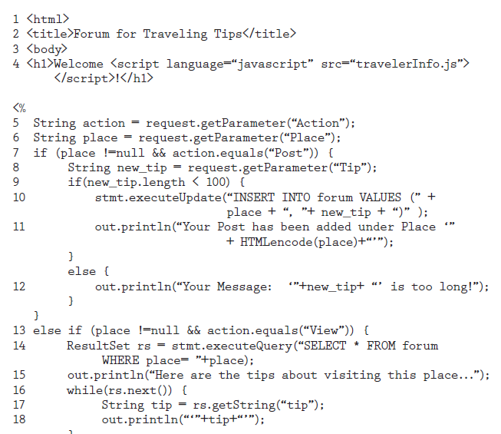

Slide 44
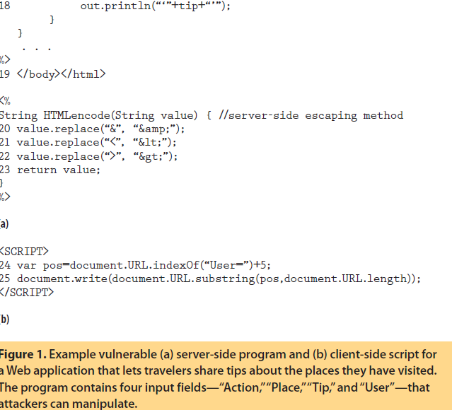

Slide 45
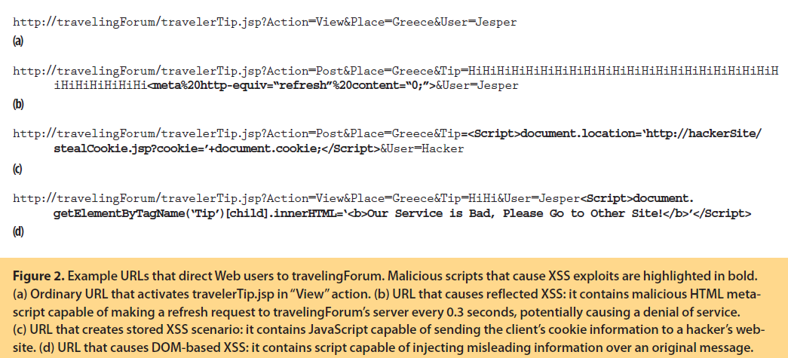

Slide 46
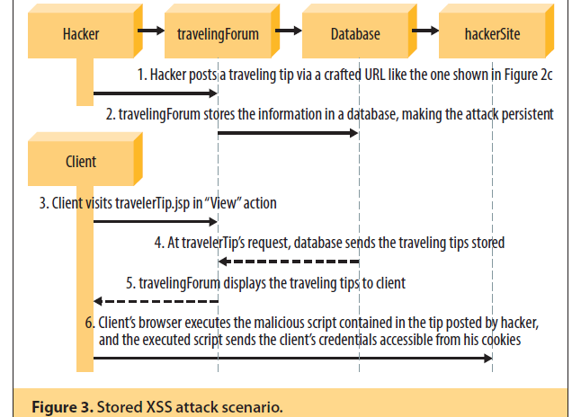

Slide 47
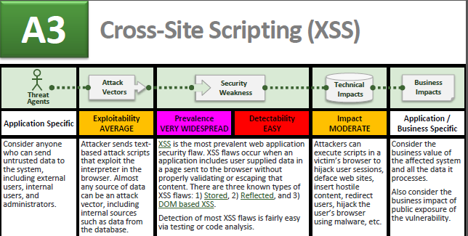
OWASP Top Ten

Slide 48
Cross-site request forgery
Also known as a one-click attack or session riding and abbreviated as CSRF or XSRF, is a type of malicious exploit of a website whereby unauthorized commands are transmitted from a user that the website trusts.
Unlike XSS, which exploits the trust a user has for a particular site, CSRF exploits the trust that a site has in a user's browser.
The attack works by including a link or script in a page that accesses a site to which the user is known (or is supposed) to have been authenticated.

Slide 49
Example
Alice, might be browsing a chat forum where another user, Eve, has posted a message. Suppose that Eve has crafted an HTML image element that references an action on Alice's bank's website (rather than an image file), e.g., <img src="http://bank.example.com/withdraw?account=Alice&amount=1000000&for=Eve">
If Alice's bank keeps her authentication information in a cookie, and if the cookie hasn't expired, then the attempt by Alice's browser to load the image will submit the withdrawal form with her cookie, thus authorizing a transaction without Alice's approval.
For the attack to be successful, an authenticated session with A must exist when the user surfs to the malicious site E. The likelihood of success can be increased by making E content-related to A, for instance to attack a banking site, the attacker poses as a site offering financial advice.

Slide 50
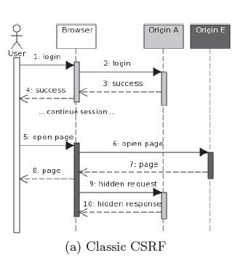

Slide 51
Misuse patterns
We did XSS: Rohini Sulatycki and Eduardo B. Fernandez, “A threat pattern for the “Cross-Site Scripting (XSS)” attack”, 22nd Conference on Pattern Languages of Programs 2015, Pittsburgh, PA, October 24-26, 2015
We do not have a pattern for CSRF

Slide 52
XML firewall [Fer13]
Controls input/output of XML applications
Detects not-well-formed documents (schema as reference)
Detects harmful data (wrong type or length)
Can perform encryption and decryption
Can sign documents or verify signatures
11/26/2018
52

Slide 53
11/26/2018
53

Slide 54
References
E.B.Fernandez, O.Ajaj, I.Buckley, N.Delessy-Gassant, K.Hashizume, M.M.Larrondo-Petrie, “A Survey of Patterns for Web Services Security and Reliability Standards.” Future Internet 2012, 4, 430-450. http://www.mdpi.com/1999-5903/4/2/430/
[Fer13] E.B.Fernandez, “Security patterns in practice: Building secure architectures using software patterns”, Wiley Series on Software Design Patterns, 2013.
[Sha12] Shar, L K, and Tan H B K, “Defending against Cross-Site Scripting Attacks," Computer 45(3), 55-62, IEEE, March 2012.

